Slide 1
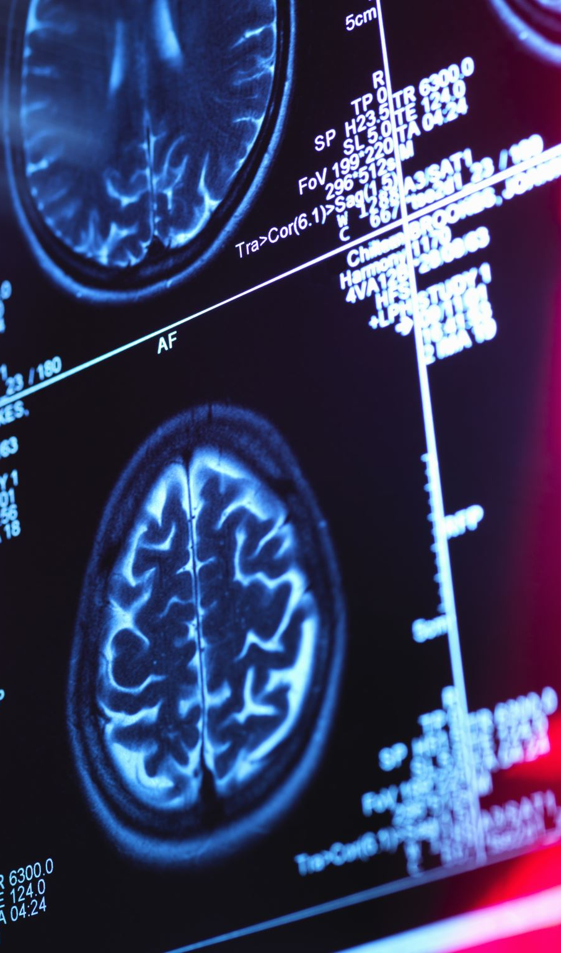
AI‑Driven Early Detection and Risk Prediction System for Alzheimer’s Disease
Group 5 – Healthcare & Medical Analytics Project Presentation

Slide 2
Problem Statement
Alzheimer’s Disease is often diagnosed late
Late diagnosis reduces effectiveness of treatment
Lack of scalable AI tools for early risk prediction
Need for data‑driven clinical decision support

Slide 3
Industry Domain
Healthcare & Medical Analytics
- Geriatric Care
- Neurology
- Preventive Medicine

Slide 4
Proposed AI Solution
• AI‑driven predictive analytics system
• Uses demographic, medical, lifestyle and cognitive data
• Machine learning predicts Alzheimer’s risk
• Generates risk classification for clinicians

Slide 5
Project Goal
Develop a reliable and interpretable AI model that predicts Alzheimer’s Disease risk using patient health and cognitive data.
Support early detection and improve clinical decision‑making.

Slide 6
Project Objective
• Build a machine learning model with at least 80% accuracy.
• Identify key risk factors using feature importance.
• Evaluate models using Accuracy, Precision, Recall, F1‑Score, ROC‑AUC.
• Ensure model interpretability.
• Align predictions with clinical indicators like MMSE and ADL.

Slide 7
Dataset
• Alzheimer’s Disease Dataset (Kaggle)
• Includes demographic, medical and lifestyle features
• Cognitive indicators such as MMSE and ADL
• Binary target variable: Alzheimer diagnosis

Slide 8
Machine Learning Models
• Logistic Regression (Baseline)
• Random Forest
• Gradient Boosting
• K‑Nearest Neighbors (KNN)

Slide 9

Agile Project Management
Project managed using Jira Agile board.
Workflow Columns:
Backlog → To Do → In Progress → Code Review → Done
One Epic, Five User Stories, Multiple Tasks.

Slide 10
System Architecture Flow
Data ingestion
Data preprocessing
Feature engineering
Model training
Model evaluation
Model explainability (SHAP)
Risk Prediction Output

Slide 11
Machine Learning Workflow
Collect
Collect patient data
Clean and prepare
Clean and prepare data
Train
Train ml models
Evaluate
Evaluate models
Select
Select best model
Explain
Explain predictions
Predict
Predict risk for new patient

Slide 12
Model Evaluation Metrics
• Accuracy
• Precision
• Recall
• F1 Score
• ROC‑AUC

Slide 13
Tools & Technologies
Python
Pandas, NumPy, Scikit‑learn
Matplotlib & Seaborn
SHAP for explainability
Jira for project management
GitHub for version control

Slide 14
Expected Impact
• Early identification of high‑risk patients
• Improved clinical decision support
• Better preventive healthcare planning
• Reduced healthcare costs
• Insights into Alzheimer’s risk factors

Slide 15

Project Resources & Links
Jira Project Board (Agile Management) Project planning, task tracking, and workflow management https://ompatel050702.atlassian.net/jira/software/projects/KAN/boards/2
Dataset Source Kaggle – Alzheimer’s Disease Dataset used for machine learning model training https://www.kaggle.com
GitHub Repository GitHub – Project code, documentation, and version control https://github.com/ompatel3457-cell/global-aging-analysis

Slide 16
Conclusion
AI and machine learning can support early detection of Alzheimer’s Disease.
Our system analyzes patient health data to predict risk and assist clinicians.
Explainable AI ensures predictions are transparent and trustworthy.

Slide 17

THANK YOU

